Slide 1

Introduction to Common Security Tools
CSE 406

Slide 2
Think Like The Adversary
“Good engineering involves thinking about how things can be made to work; the security mindset involves thinking about how things can be made to fail. It involves thinking like an attacker, an adversary or a criminal. You don’t have to exploit the vulnerabilities you find, but if you don’t see the world that way, you’ll never notice most security problems.” -- Bruce Schneier

Slide 3
Ethics
I will not engage in any unethical or unlawful acts.
I will only apply my knowledge on the systems I own
Must have written permission to test any system

Slide 4
General Pipeline
Ping /whois/ traceroute/ Social Engineering/ DNSLookup
Scan open ports/ Underlying OS (NMap)
Identify Vulnerable Services Running on those ports
Go to CVE details
Apply different techniques to exploit the vulnerability
Deploy payload
Report findings

Slide 5
Port Scanning
Services run on ports
Ports of Interest
Running services with known vulnerability
E.g., Buffer Overflow
Ports can be
Open
Closed
Filtered (e.g. firewall rules are employed)

Slide 6
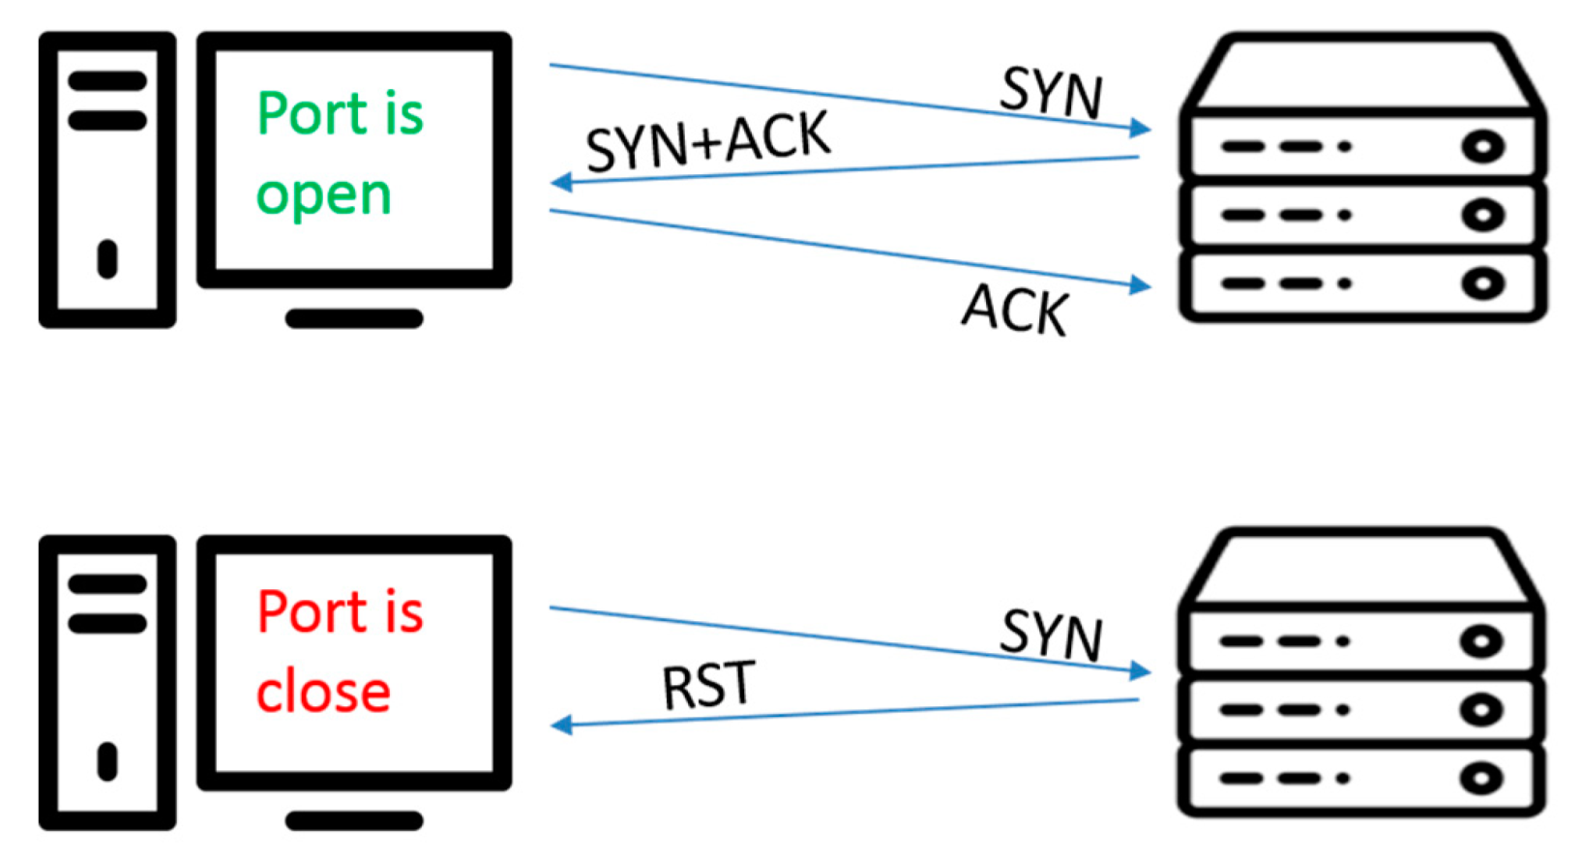
Check for Open ports

Slide 7
Nmap
Scan ports
List services
List the OS

Slide 8
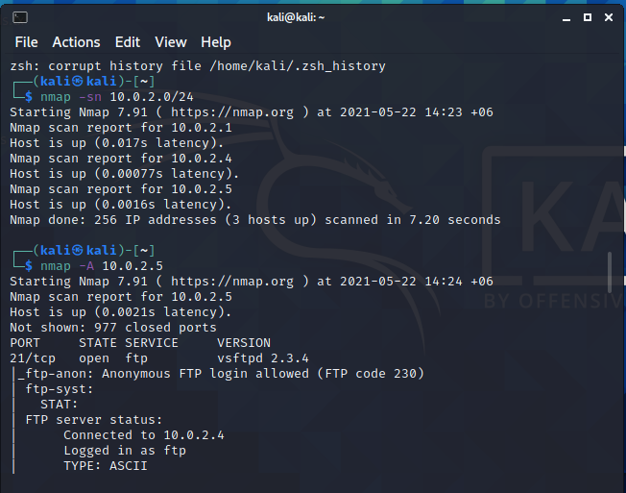
Nmap
Host Discovery
Target Ip Metasploit machine
Port Scanning With Aggressive OS Detection
Aggressive mode only scans well known ports

Slide 9
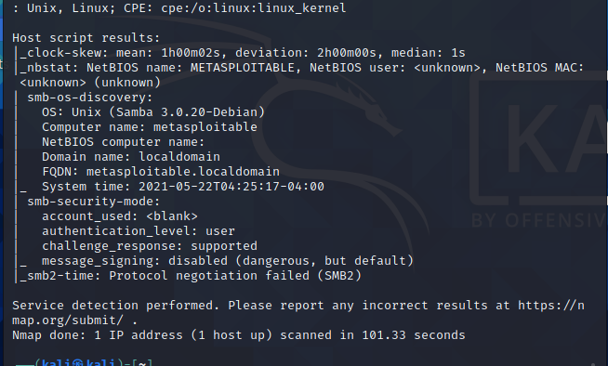
Nmap
OS Detected

Slide 10
Guess!
How can OS detection be useful?

Slide 11
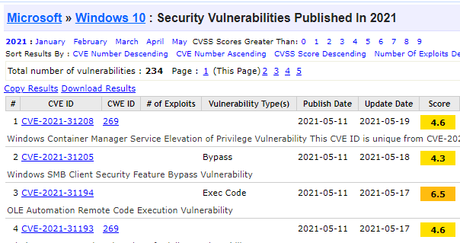
Nmap

Slide 12
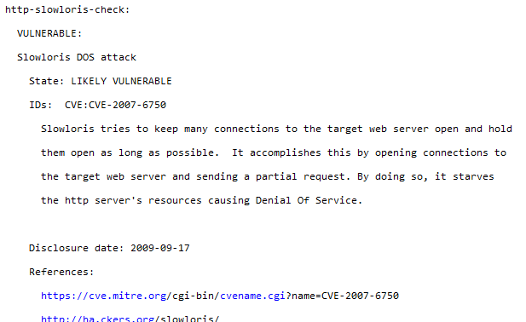
Vulnerability Testing with Nmap Scripts
nmap --script vuln <host>

Slide 13
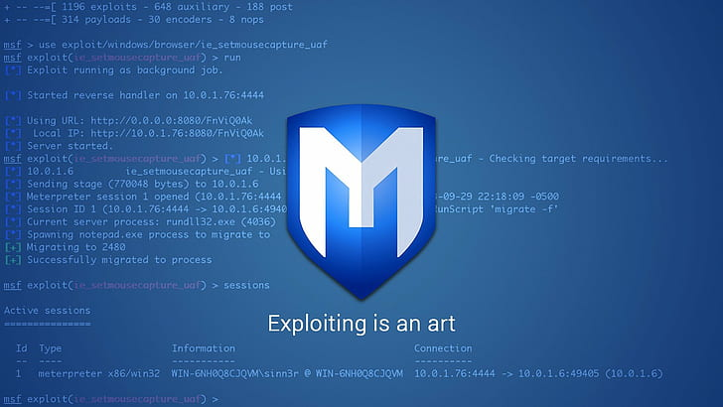
Metasploit

Slide 14
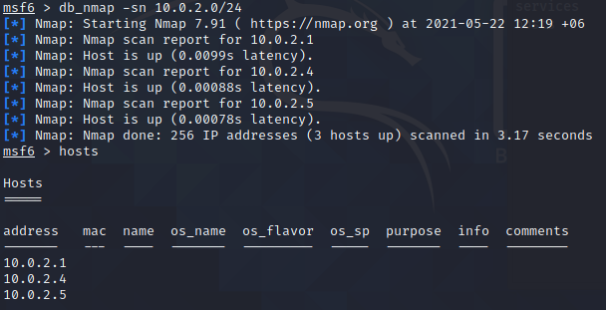
Host Discovery

Slide 15
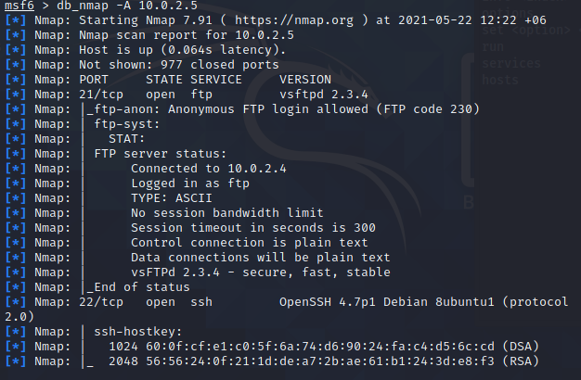
Scanning Open Ports

Slide 16
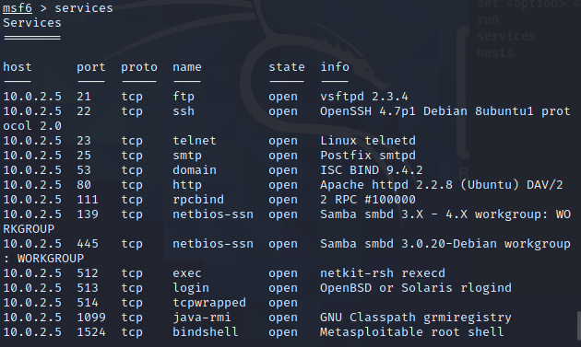
Listing Services

Slide 17
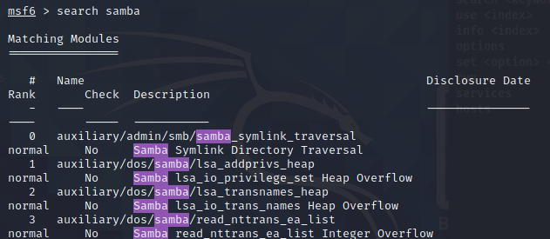
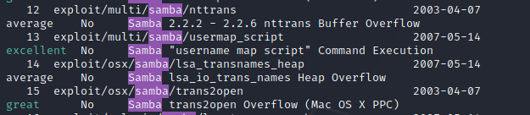
Search for Built-in Exploits

Slide 18

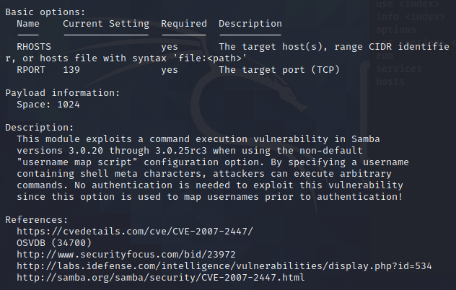
Details of the Exploit

Slide 19
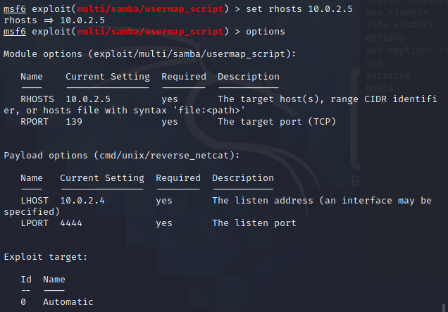
Set Options for the Exploit

Slide 20
Set Payload
An exploit is a piece of code that runs on our own machine and attempts to take advantage of a bug in some server software to enable us to do something to the target machine.
When we run an exploit, we usually provide the exploit with a payload: a piece of software that will run on the target machine to accomplish our goals.
A very common (and desirable) payload type is a shell
we can execute arbitrary commands on the target system.

Slide 21
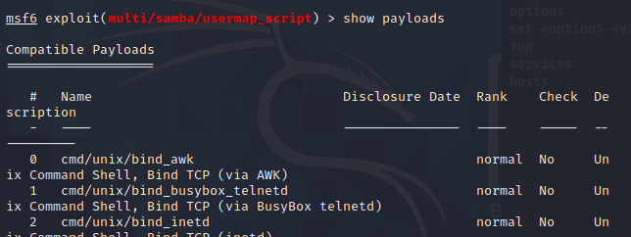
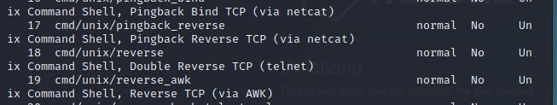
Set Payload

Slide 22
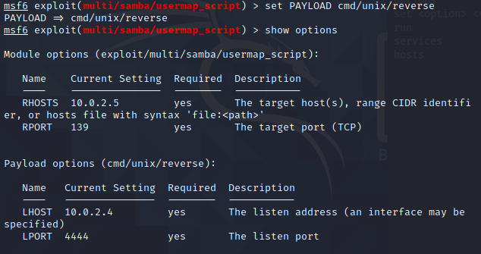
Set Payload

Slide 23
Reverse Payload
In a reverse payload, by contrast, an attacker uses the initial code execution to have the victim’s machine reach back out to the attacker’s machine for command and control. WHY???
In this method, the attacker sets up a listening port and waits for the victim machine to reach back out and install the payload. This flow works in reverse to a bind payload, hence the name.

Slide 24
Guess!
Among RHOST and LHOST, which one is the victim machine?

Slide 25
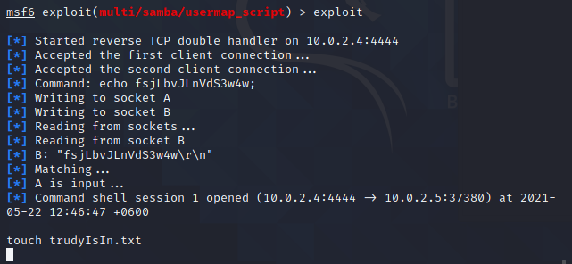
Carry Out the Exploit

Slide 26
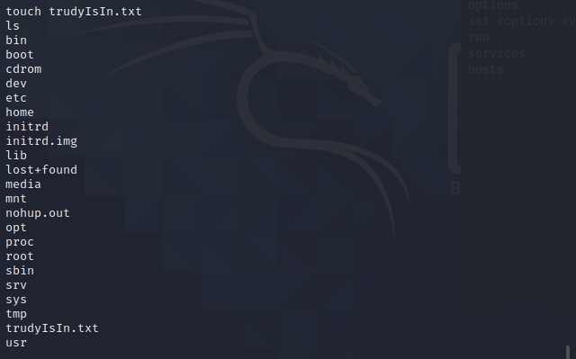
Carry Out the Exploit

Slide 27

Nessus

Slide 28
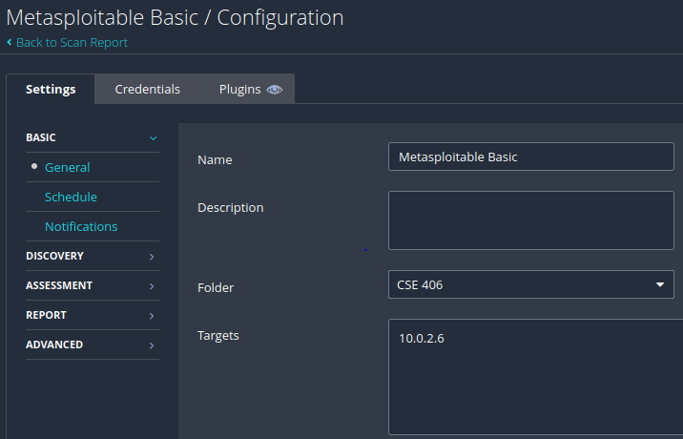
Nessus

Slide 29
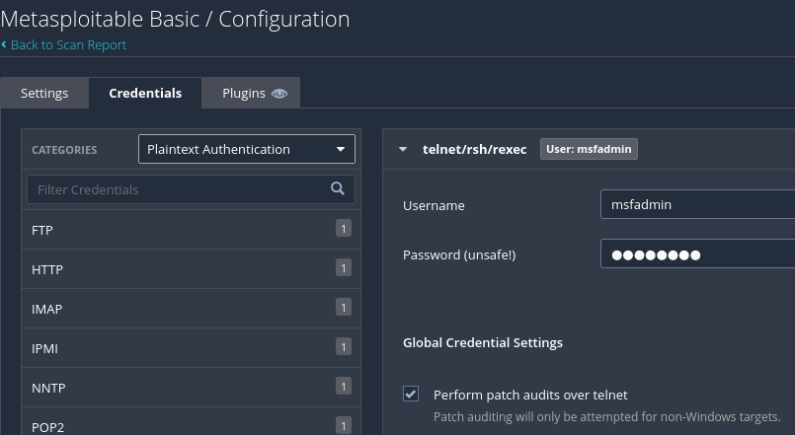
Nessus

Slide 30
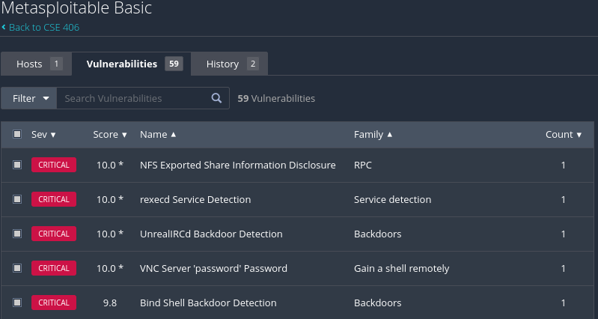
Nessus

Slide 31

Hydra
Brute Force Password Cracking
https://linuxconfig.org/ssh-password-testing-with-hydra-on-kali-linux

Slide 32
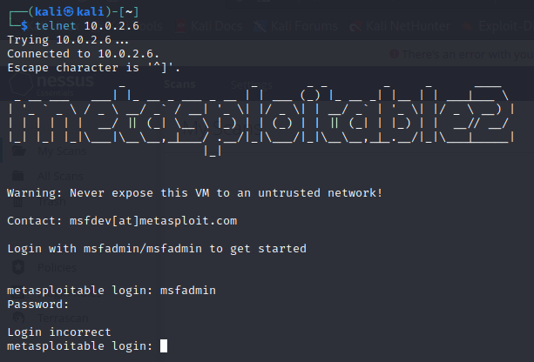
Hydra

Slide 33
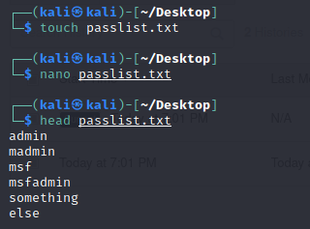
Hydra

Slide 34
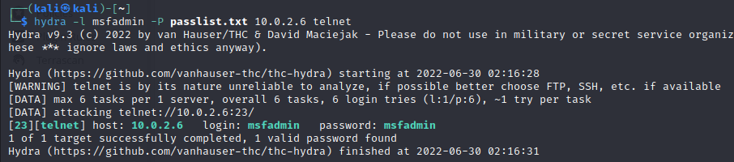
Hydra

Slide 35
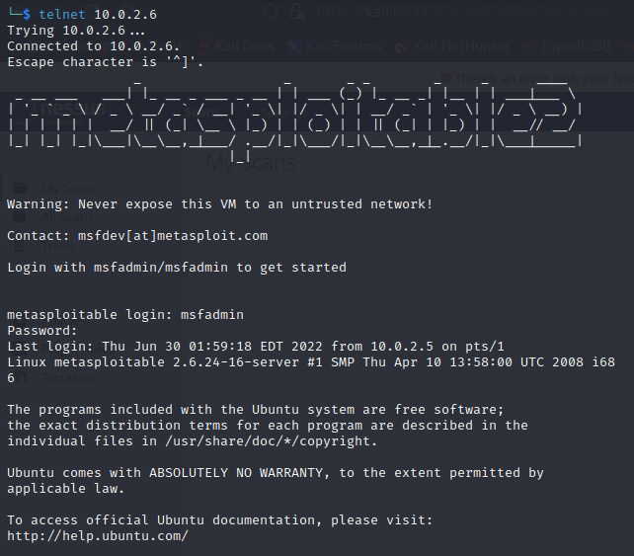
Hydra

Slide 36
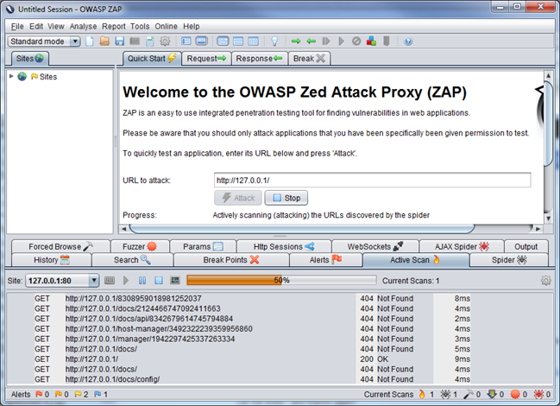

Other Web Scanners

Slide 37

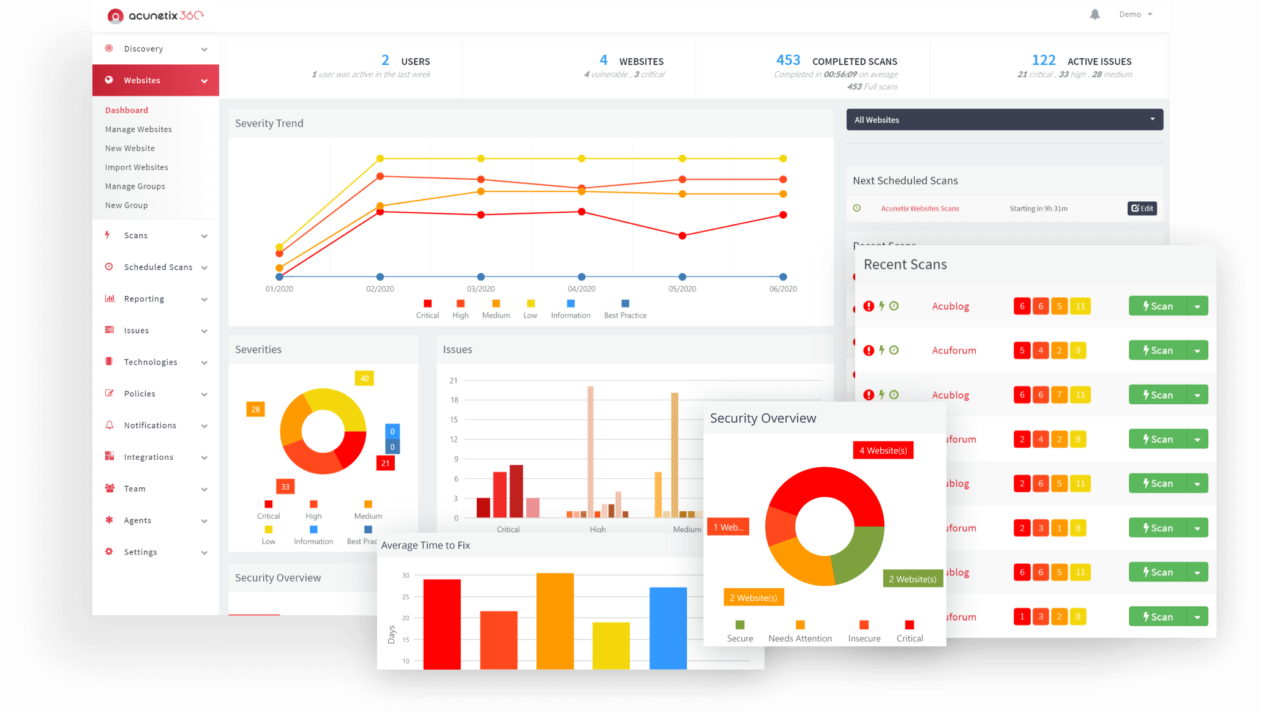
Other Web Scanners

Slide 38
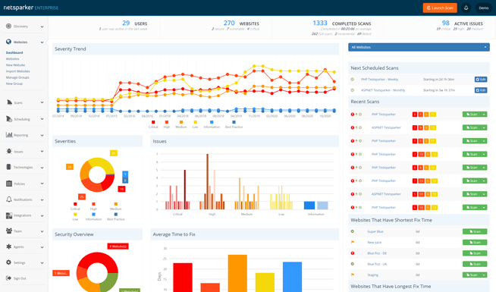

Other Web Scanners

Slide 39

Android App Analyzer
Mob SF (Dynamic + Static)
Androbugs
Qark
Oversecurity

Slide 40
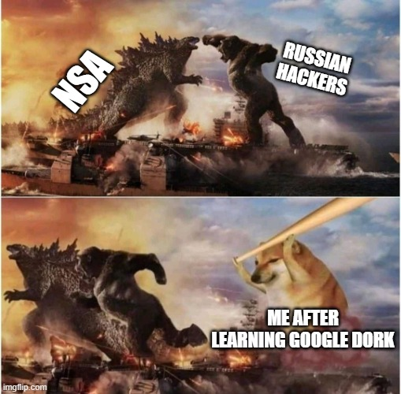
Party Tricks

Slide 41
Party Tricks
Exploit DB
https://www.exploit-db.com/
Google Dork
https://securitytrails.com/blog/google-hacking-techniques

Slide 42
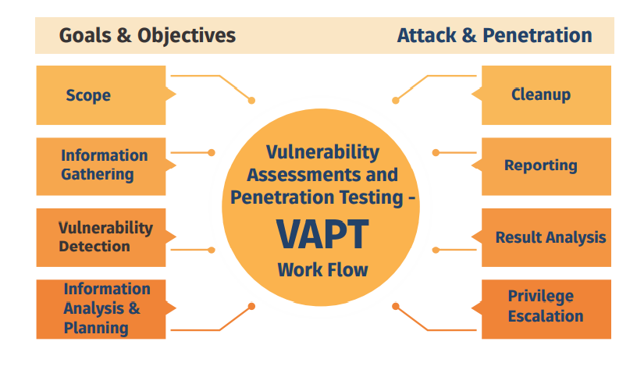
What is VAPT?

